Slide 1
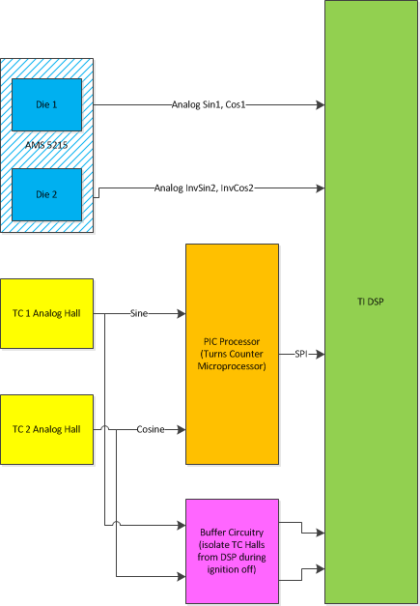
SE45B – Limp Home Motor Position Sensor including Redundant Motor Position Sensor (2 Analog Halls)
Description
  Provide “Limp Home” (fault tolerant) functionality for diagnostic failures of one of the two primary motor position signals of the dual die motor position sensor.
  Utilize two analog hall sensors as redundant (tertiary) motor position signal (as used in the Turns Counter function for Ford) as the diagnostic check for the remaining healthy motor position signal (die) while in Limp Home mode.
Motivation (Performance, 3/4)
Deliverables
  System, subsystem, and FDD requirements for function.
  Prototype software suitable for customer use on test track.
  Final production SW FDD’s
  Test plans
  Modifications to EOL cal process for analog hall signals
Timing
  FDD requirements for PSR complete by June 15, 2014
  PSR Software to customer by end of August 2014
  SOP, Ford S550, March 2016
  SOP, GM T1XX Level 2, April 2018
Team Members/Customers
  Systems - MC&S: Julie Kleinau, Prerit Pramod, Julius Woo
  Systems – Functional Safety: Kathy Pattok, Scott Weiss,
  Mark Norman
  E&ES – Jason Erlenbeck, Ishtiaque Amin
  SW – Selva Sengottaiyan
  Powerpack – Ken Sabol
  Customers – Ford S550/P552 PDT, GM T1XX Pursuit Team

Slide 2
SE45B – Limp Home Motor Position Sensor including Redundant Motor Position Sensor (2 Analog Halls)
Status
  System Level Requirements Drafted, in Doors EA and MSS spec templates.
  FDD Model based Requirements and tool updates completed for customer demo PSR.
  Hardware received which routes analog hall sensors directly to DSP (instead of through PIC SPI interface).
  PSR for customer demo completed and demonstrated to the customer.
  Requirements for Motor Position function handed off to ES team (Jason Erlenbeck) for development of production versions of FDD. Corrections for signal offset (room temp only), quadrature error, and amplitude included. No harmonic corrections.
  Analog hall (tertiary signal) error mapping performed for one board/magnet combination. Data analysis required to determine total angle error of measurement over stack alignment error.
  Field mapping completed multiple 6 mm sense magnets. Significant production part to part variation observed in field strength.
  Model analysis performed using magnet field strength map (nominal) and tolerances to predict largest expected tertiary angle error. (Model predicts harmonic error uncompensated can exceed 30 degrees mechanical).
  Hardware testing of alternate tertiary sensor performed (Infineon TLE 5009) completed at room temperature. Potential cost savings and is significantly lower error before EOL calibration. Candidate for T1XX/9BXX.
Challenges
  Confirm Stack Analysis of motor angle derived from Turns Counter halls signals, raw signals have significant amplitude mismatch, offset error, quadrature error.
    Model complete, but predicts higher amplitudes than measured.
    Magnetic field maps similar to model predictions other than part to part variation. Does not explain all of difference.
    Test result map of signal amplitudes with new MSB’s (Ford radius) are within about 10% of predicted amplitude.
    Testing may indicate a requirement addition of run time offset learning to SW – need to complete thermal studies.
    Root cause analysis of model/test mismatch.
  Test function on a “worst case” stack part to confirm robust function. (MC team/Electrical team)
    Create a special MSB with one sensor at min radius and the other at max radius.
  Repeat model exercise at new sensor radius for T1XX/9BXX.
  Build T1XX test board with correct radius for mapping and map error over expected alignment stack for model verification.
  Ditto for 9Bxx.
  EEPROM memory allocation for die 2 harmonic correction tables.
  Development of pass/fail criteria for EOL manufacturing and prototype center calibration process.
  Process equipment SW updates – requirements, release, test.

Slide 3
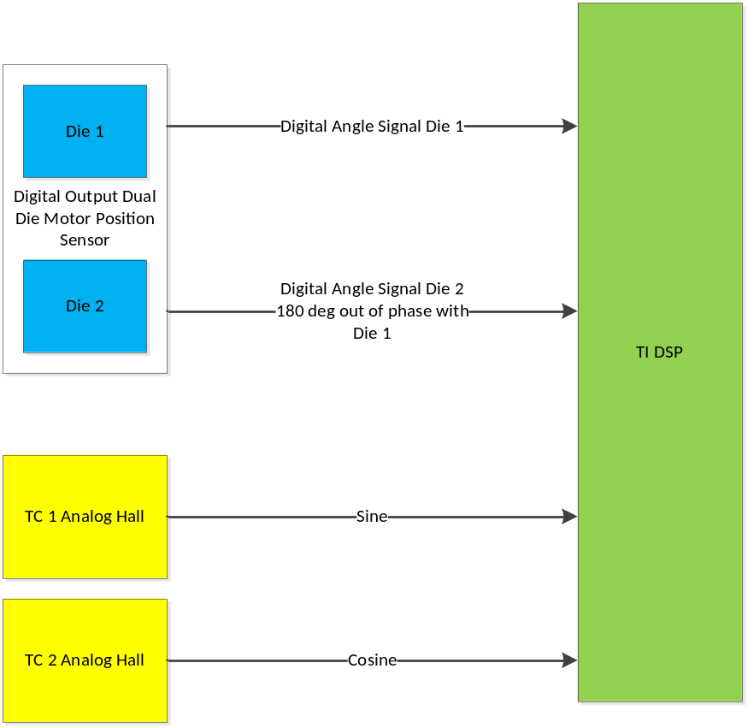
SE45B – Limp Home Motor Position Sensor including Redundant Motor Position Sensor (2 Analog Halls)
GM T1XX/9BXX Level 2 Proposal

Slide 4
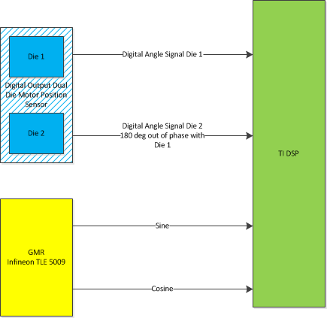
SE45B – Limp Home Motor Position Sensor including Redundant Motor Position Sensor (Single Die GMR)
GM T1XX/9BXX Level 2 Proposal (alternate)

